Slide 1
Digital Signaling & Shift Keying Techniques
Sujoy Mukherjee
sujoymukherjee@ieee.org

Slide 2
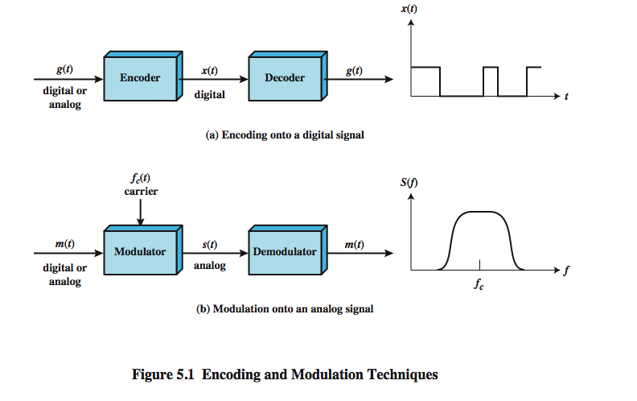
Encoding and Modulation Techniques
2/45
Notes:
Have already noted in Ch 3 that both analog and digital information can be encoded as either analog or digital signals:
Digital data, digital signals: simplest form of digital encoding of digital data
Digital data, analog signal: A modem converts digital data to an analog signal so that it can be transmitted over an analog
Analog data, digital signals: Analog data, such as voice and video, are often digitized to be able to use digital transmission facilities
Analog data, analog signals: Analog data are modulated by a carrier frequency to produce an analog signal in a different frequency band, which can be utilized on an analog transmission system
Stallings DCC8e Fig 5.1 emphasizes the process involved in this. For digital signaling, a data source g(t), which may be either digital or analog, is encoded into a digital signal x(t). The basis for analog signaling is a continuous constant-frequency f_{c} signal known as the carrier signal. Data may be transmitted using a carrier signal by modulation, which is the process of encoding source data onto the carrier signal. All modulation techniques involve operation on one or more of the three fundamental frequency domain parameters: amplitude, frequency, and phase. The input signal m(t) may be analog or digital and is called the modulating signal, and the result of modulating the carrier signal is called the modulated signal s(t).

Slide 3
Digital Signaling Versus Analog Signaling
Digital signaling
  Digital or analog data is encoded into a digital signal
  Encoding may be chosen to conserve bandwidth or to minimize error
Analog Signaling
  Digital or analog data modulates analog carrier signal
  The frequency of the carrier fc is chosen to be compatible with the transmission medium used
  Modulation: the amplitude, frequency or phase of the carrier signal is varied in accordance with the modulating data signal
  by using different carrier frequencies, multiple data signals (users) can share the same transmission medium
3/45

Slide 4
Digital Signaling
Digital data, digital signal
  Simplest encoding scheme: assign one voltage level to binary one and another voltage level to binary zero
  More complex encoding schemes: are used to improve performance (reduce transmission bandwidth and minimize errors).
  Examples are NRZ-L, NRZI, Manchester, etc.
Analog data, Digital signal
  Analog data, such as voice and video
  Often digitized to be able to use digital transmission facility
  Example: Pulse Code Modulation (PCM), which involves sampling the analog data periodically and quantizing the samples
4/45

Slide 5
Analog Signaling
Digital data, Analog Signal
  A modem converts digital data to an analog signal so that it can be transmitted over an analog line
  The digital data modulates the amplitude, frequency, or phase of a carrier analog signal
  Examples: Amplitude Shift Keying (ASK), Frequency Shift Keying (FSK), Phase Shift Keying (PSK)
Analog data, Analog Signal
  Analog data, such as voice and video modulate the amplitude, frequency, or phase of a carrier signal to produce an analog signal in a different frequency band
  Examples: Amplitude Modulation (AM), Frequency Modulation (FM), Phase Modulation (PM)
5/45

Slide 6
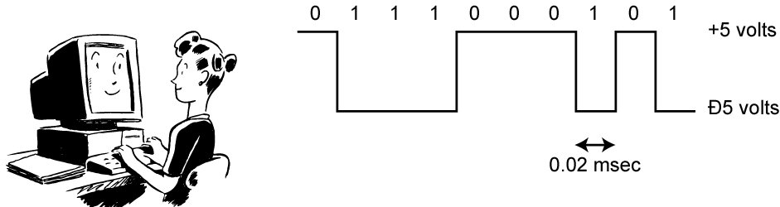
Digital Data, Digital Signal
Digital signal
  discrete, discontinuous voltage pulses
  each pulse is a signal element
  binary data encoded into signal elements
6/45
Notes:
Encoding - Digital data to digital signals: A digital signal is a sequence of discrete, discontinuous voltage pulses, as illustrated in Stallings DCC8e Figure 3.13. Each pulse is a signal element. Binary data are transmitted by encoding each data bit into signal elements. In the simplest case, there is a one-to-one correspondence between bits and signal elements. More complex encoding schemes are used to improve performance, by altering the spectrum of the signal and providing synchronization capability. In general, the equipment for encoding digital data into a digital signal is less complex and less expensive than digital-to-analog modulation equipment

Slide 7
Periodic signals
Data element: a single binary 1 or 0
Signal element: a voltage pulse of constant amplitude
Unipolar: All signal elements have the same sign
Polar: One logic state represented by positive voltage the other by negative voltage
Data rate: Rate of data (R) transmission in bits per second
Duration or length of a bit: Time taken for transmitter to emit the bit (T_{b}=1/R)
Modulation rate: Rate at which the signal level changes, measured in baud = signal elements per second. Depends on type of digital encoding used.
7/45
Notes:
Before discussing this further, we need to define some terms:
Unipolar - All signal elements have the same sign
Polar - One logic state represented by positive voltage the other by negative voltage
Data rate - Rate of data (R) transmission in bits per second
Duration or length of a bit - Time taken for transmitter to emit the bit (1/R)
Modulation rate -Rate at which the signal level changes, measured in baud = signal elements per second. Depends on type of digital encoding used.
Mark and Space - Binary 1 and Binary 0 respectively

Slide 8
Interpreting Signals
Need to know
  timing of bits: when they start and end
  signal levels: high or low
factors affecting signal interpretation
  Data rate: increase data rate increases Bit Error Rate (BER)
  Signal to Noise Ratio (SNR): increase SNR decrease BER
  Bandwidth: increase bandwidth increase data rate
  encoding scheme: mapping from data bits to signal elements
8/45
Notes:
The tasks involved in interpreting digital signals at the receiver can be summarized as follows. First, the receiver must know the timing of each bit, knowing with some accuracy when a bit begins and ends. Second, the receiver must determine whether the signal level for each bit position is high (0) or low (1). These tasks can be performed by sampling each bit position in the middle of the interval and comparing the value to a threshold. Because of noise and other impairments, there will be errors. As was shown in Chapter 3, three factors are important: the signal-to-noise ratio, the data rate, and the bandwidth. With other factors held constant, the following statements are true:
• An increase in data rate increases bit error rate (BER).
• An increase in SNR decreases bit error rate.
• An increase in bandwidth allows an increase in data rate.
There is another factor that can be used to improve performance, and that is the encoding scheme. The encoding scheme is simply the mapping from data bits to signal elements. A variety of approaches have been tried. In what follows, we describe some of the more common ones.

Slide 9
Comparison of Encoding Schemes
signal spectrum
  Lack of high frequencies reduces required bandwidth,
  lack of dc component allows ac coupling via transformer, providing isolation,
  should concentrate power in the middle of the bandwidth
Clocking
  synchronizing transmitter and receiver with a sync mechanism based on suitable encoding
error detection
  useful if can be built in to signal encoding
signal interference and noise immunity
cost and complexity: increases when increases data rate
9/45
Notes:
Before describing the various encoding techniques, consider the following ways of evaluating or comparing them:
Signal Spectrum - Lack of high frequencies reduces required bandwidth, lack of dc component allows ac coupling via transformer, providing isolation, should concentrate power in the middle of the bandwidth
Clocking - need for synchronizing transmitter and receiver either with an external clock or with a sync mechanism based on signal
Error detection - useful if can be built in to signal encoding
Signal interference and noise immunity - some codes are better than others
Cost and complexity - Higher signal rate (& thus data rate) lead to higher costs, some codes require signal rate greater than data rate

Slide 10
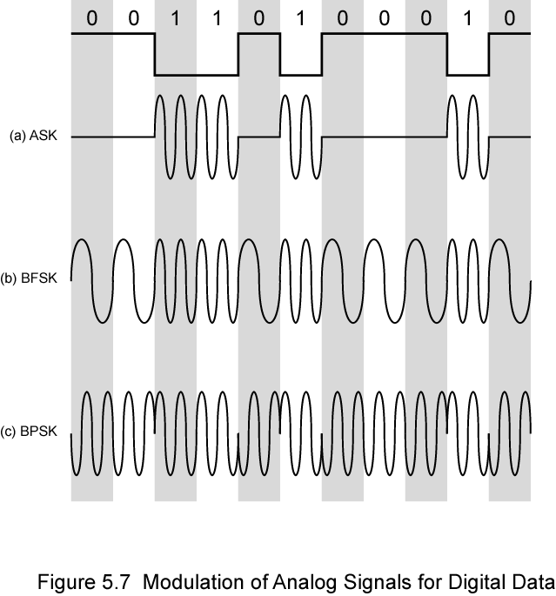
Modulation Techniques
Amplitude Shift Keying (ASK)
Binary Frequency Shift Keying (BFSK)
Binary Phase Shift Keying (BPSK)
28/45
Notes:
Have stated that modulation involves operation on one or more of the three characteristics of a carrier signal: amplitude, frequency, and phase. Accordingly, there are three basic encoding or modulation techniques for transforming digital data into analog signals, as illustrated in Stallings DCC8e Figure 5.7 (above): amplitude shift keying (ASK), frequency shift keying (FSK), and phase shift keying (PSK). In all these cases, the resulting signal occupies a bandwidth centered on the carrier frequency.

Slide 11
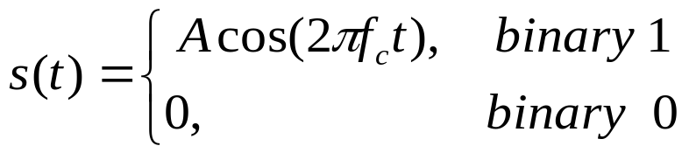
Amplitude Shift Keying (ASK)
In ASK, the two binary values are represented by to different amplitudes of the carrier frequency
The resulting modulated signal for one bit time is
Susceptible to noise
Inefficient modulation technique
used for
  up to 1200bps on voice grade lines
  very high speeds over optical fiber
29/45
Notes:
In ASK, the two binary values are represented by two different amplitudes of the carrier frequency. Commonly, one of the amplitudes is zero; that is, one binary digit is represented by the presence, at constant amplitude, of the carrier, the other by the absence of the carrier, as shown in Stallings DCC8e Figure 5.7a.
ASK is susceptible to sudden gain changes and is a rather inefficient modulation technique. On voice-grade lines, it is typically used only up to 1200 bps.
The ASK technique is used to transmit digital data over optical fiber, where one signal element is represented by a light pulse while the other signal element is represented by the absence of light.

Slide 12
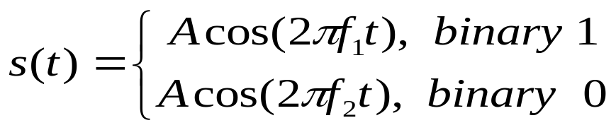
Binary Frequency Shift Keying (BFSK)
The most common form of FSK is Binary FSK (BFSK)
Two binary values represented by two different frequencies ( f₁ and f₂ )
less susceptible to noise than ASK
used for
  up to 1200bps on voice grade lines
  high frequency radio (3 to 30MHz)
  even higher frequency on LANs using coaxial cable
0 | 0 | 1 | 1 | 0 | 1 | 0 | 0 | 0 | 1 | 0
f₂ | f₂ | f₁ | f₁ | f₂ | f₁ | f₂ | f₂ | f₂ | f₁ | f₂
30/45
Notes:
The most common form of FSK is binary FSK (BFSK), in which the two binary values are represented by two different frequencies near the carrier frequency, as shown in Stallings DCC8e Figure 5.7b.
BFSK is less susceptible to error than ASK. On voice-grade lines, it is typically used up to 1200 bps. It is also commonly used for high-frequency (3 to 30 MHz) radio transmission. It can also be used at even higher frequencies on local area networks that use coaxial cable.

Slide 13
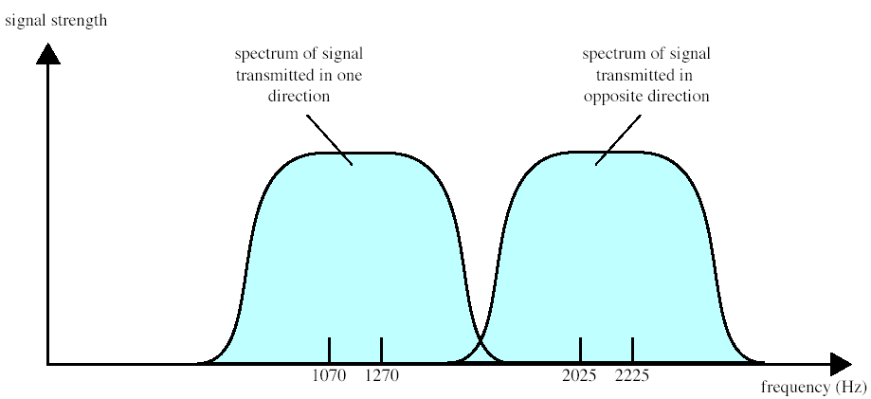
Full-Duplex BFSK Transmission on
a Voice-Grade line
Voice grade lines will pass voice frequencies in the range 300 to 3400Hz
Full duplex means that signals are transmitted in both directions at the same time
f₁
f₂
f ₃
f₄
31/45

Slide 14
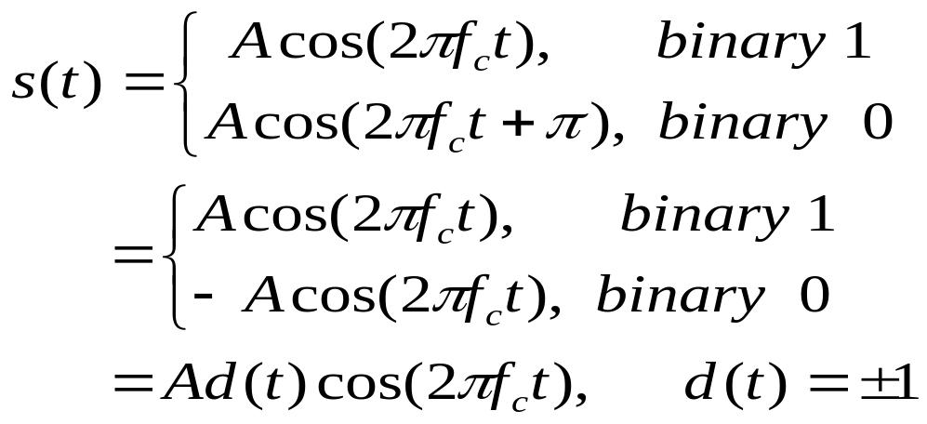
Phase Shift Keying (PSK)
Phase of carrier signal is shifted to represent data
Binary PSK (BPSK): two phases represent two binary digits
0 | 0 | 1 | 1 | 0 | 1 | 0 | 0 | 0 | 1 | 0
π | Π | 0 | 0 | π | 0 | π | π | π | 0 | π
36/45
Notes:
In PSK, the phase of the carrier signal is shifted to represent data. The simplest scheme uses two phases to represent the two binary digits (Figure 5.7c) and is known as binary phase shift keying.
An alternative form of two-level PSK is differential PSK (DPSK). In this scheme, a binary 0 is represented by sending a signal burst of the same phase as the previous signal burst sent. A binary 1 is represented by sending a signal burst of opposite phase to the preceding one. This term differential refers to the fact that the phase shift is with reference to the previous bit transmitted rather than to some constant reference signal. In differential encoding, the information to be transmitted is represented in terms of the changes between successive data symbols rather than the signal elements themselves. DPSK avoids the requirement for an accurate local oscillator phase at the receiver that is matched with the transmitter. As long as the preceding phase is received correctly, the phase reference is accurate.

